Slide 1
Class1215-Ex01
Matlab

Slide 2
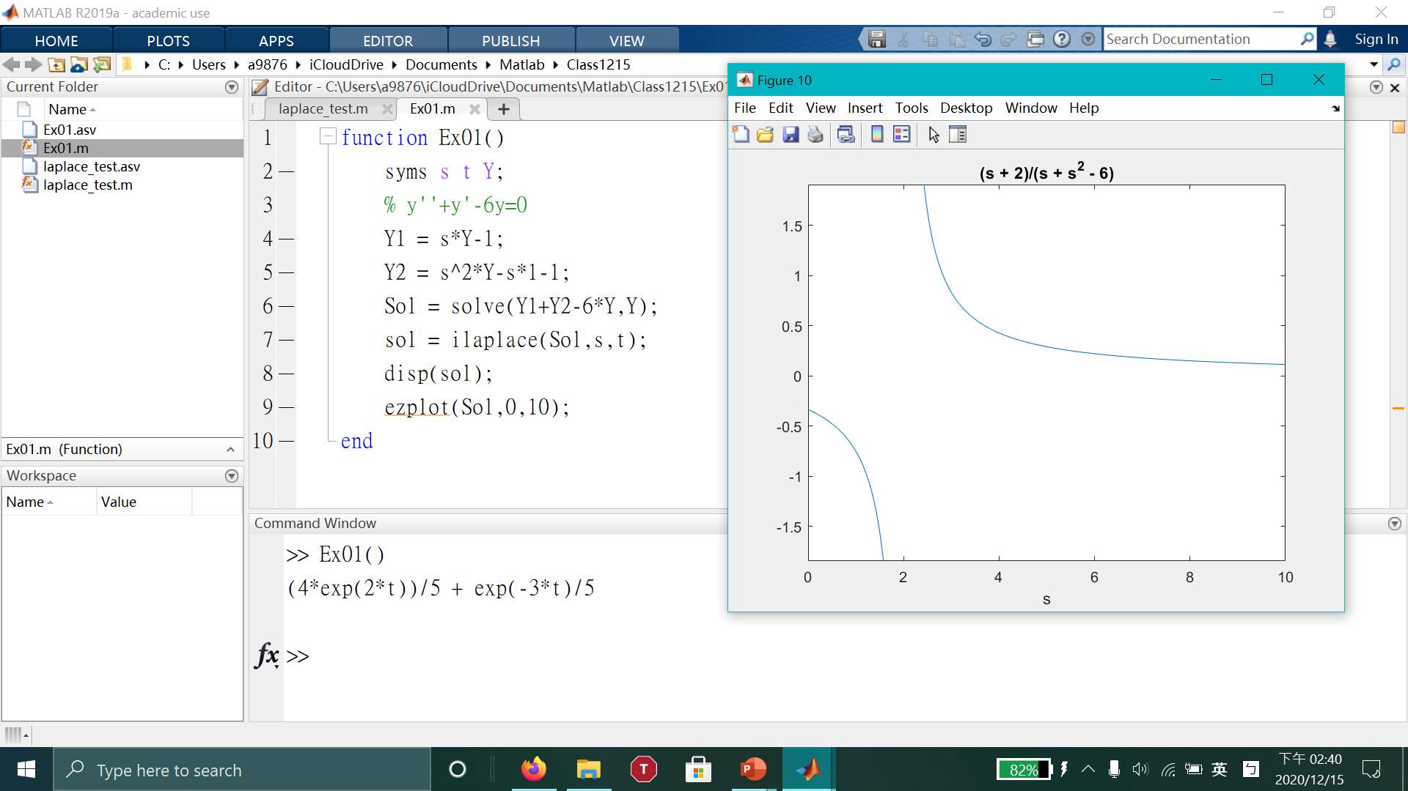

Slide 3
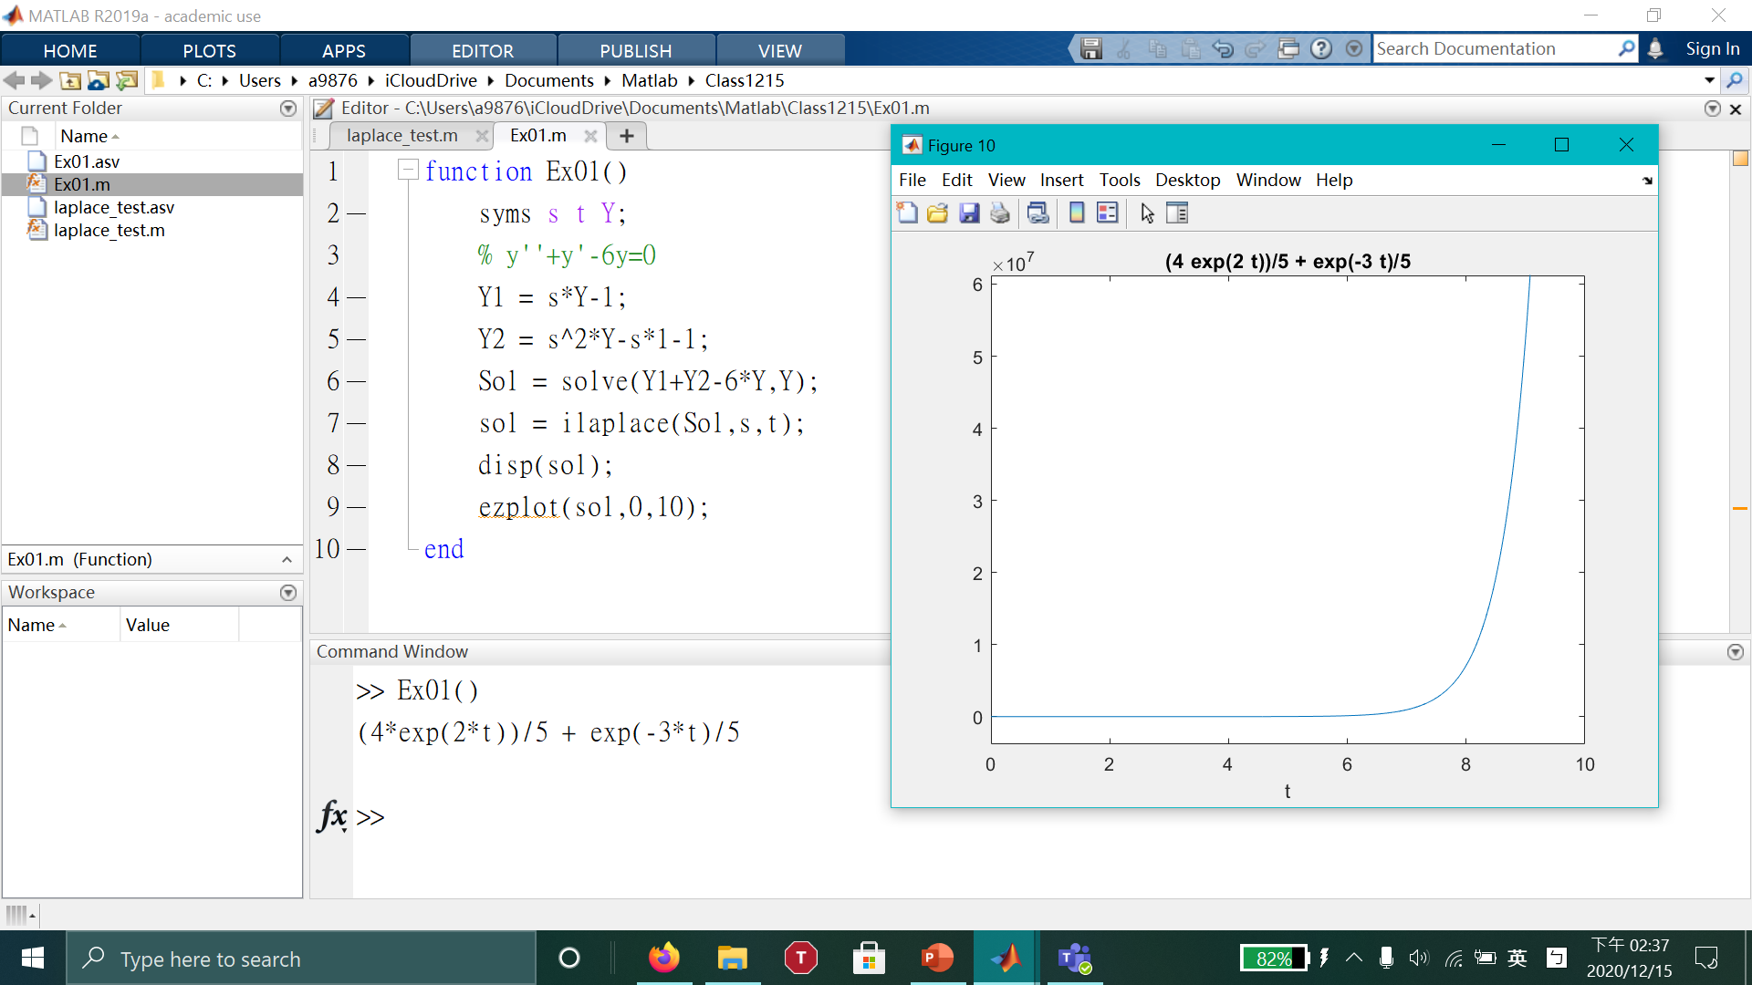

Slide 4
Class1215-Ex02
Matlab

Slide 5
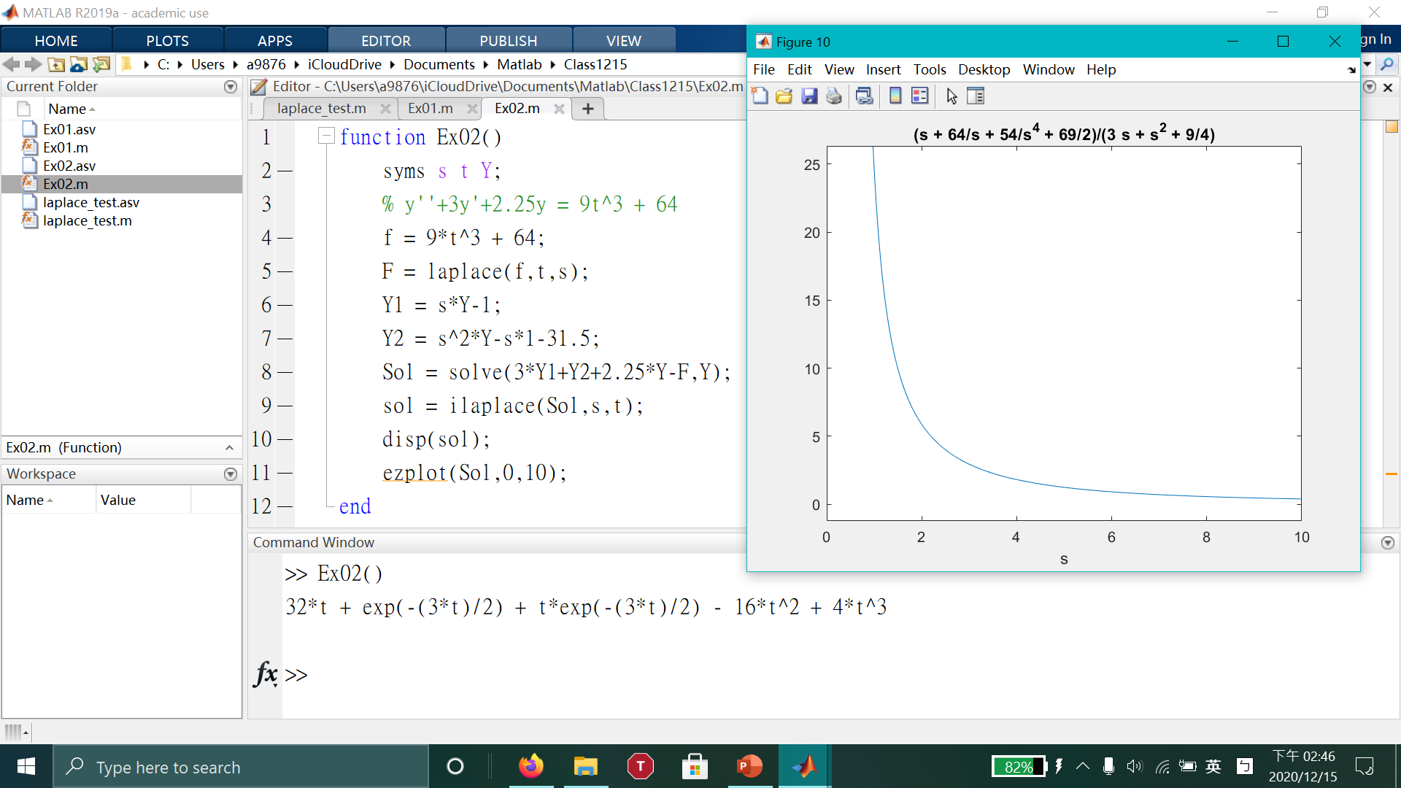

Slide 6
